Slide 1

Road to EDA Tool Developer
Hyunjong Song

Slide 2
Table of contents
1. Project Overview
2. EDA Flow Summary
3. RTL Design & Simulation
4. Synthesis
5. Place and Route
6. Tool Analysis & Customization
7. Results & Layout Output
8. Key Learnings & Technical Growth

Slide 3
Project Overview
“From RTL to Silicon: Automating the Digital Design Flow”

Slide 4
EDA Flow Summary
RTL Design
Simulation
Synthesis
Floorplan
Place
Route
STA
GDS Export

Slide 5
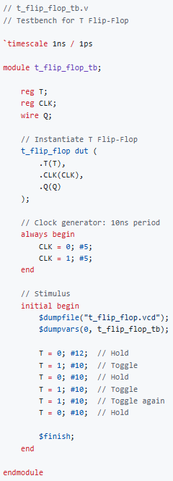
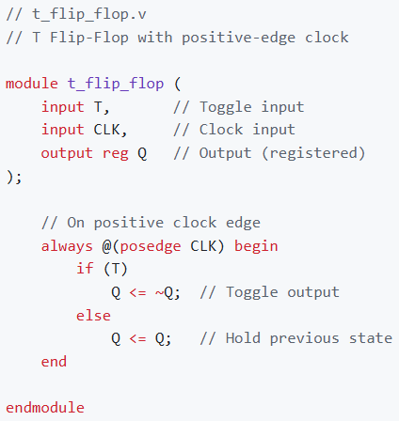

RTL Design & Simulation

Slide 6
Synthesis
12
30
6
Greatest Common Divisor

Slide 7
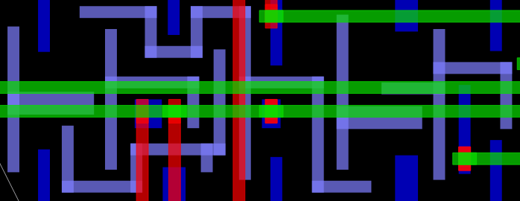
Place and Route

Slide 8

Tool Analysis & Customization
variables.yaml
config.mk
defaults.py
config.mk
variables.mk
preprocessLib.py
Makefile

Slide 9
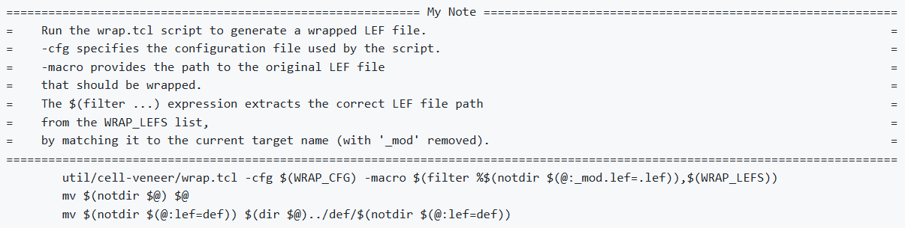
Tool Analysis & Customization
variables.yaml
config.mk
defaults.py
config.mk
variables.mk
preprocessLib.py
Makefile

Slide 10
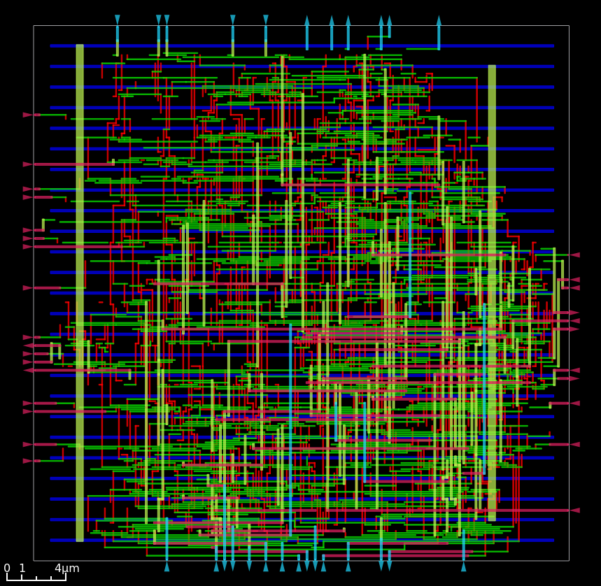
Results & Layout Output

Slide 11
Key Learnings & Technical Growth
Understanding of the behaviors of various scripting languages(Makefile, Tcl, YAML, etc.) enhancing my ability to interpret and debug automated design flows
Understanding of how digital circuits are designed through each stage of the hardware design flow, from RTL to layout
Gained hands-on experience using open-source EDA tools in a Linux environment through the Ubuntu terminal
Gained familiarity with GitHub for managing and tracking project progress

Slide 12
Key Learnings & Technical Growth
https://github.com/Luffy-HJ/vlsi-lab

